Slide 1
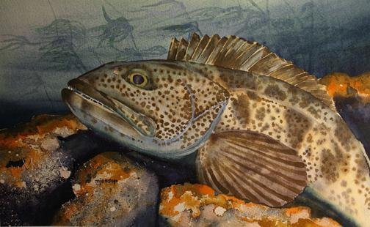
An analysis of risk pools in commercial ITQ fisheries:
Quantifying social, economic, and biological linkages in the US West coast groundfish trawl fishery
Nadine Heck¹, Kelli F. Johnson², Sarah Klain³, and Ana K. Spalding⁴
¹Institute of Marine Sciences, University of California, 1156 High St., Santa Cruz, CA 95064, USA
²School of Aquatic and Fishery Sciences, University of Washington, Box 355020 Seattle, WA 98195-5020, USA
³Institute for Resources Environment and Sustainability, University of British Columbia, Vancouver BC V6T 1Z4, Canada
⁴Smithsonian Tropical Research Institute, Apartado Postal 0843-03092, Panamá, República de Panamá
Mark Jessop

Slide 2
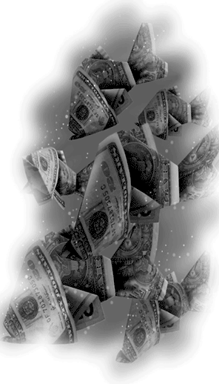
ORIGINAL PROJECT:
What drives fishing effort in coastal Washington, Oregon, and California?
Source: The Seattle Times
Notes:
Our original question came from Todd Lee, NOAA economist. They provided the economic and ecological (trawl survey data, available from 2003) data between 2009-2012, and specifically asked for the following:
- combine ecological (groundfish survey) & economic (landings & revenue) data
BROAD

Slide 3


ORIGINAL PROJECT (Day 1):
Social Scientists
Quantitative Scientist
?????
COMPLETE SILENCE!!!!

Slide 4
ORIGINAL PROJECT (Day 2):
Social Scientists
Quantitative Scientist
???
Attempt to find a common language
Notes:
- Discussed our skills (Sarah proposed mapping survey data as a way to link ecological and economic data).
- Other ideas that emerged included: mapping changes in behavior (fishing location) based on existing data; correlating economy and biology

Slide 5
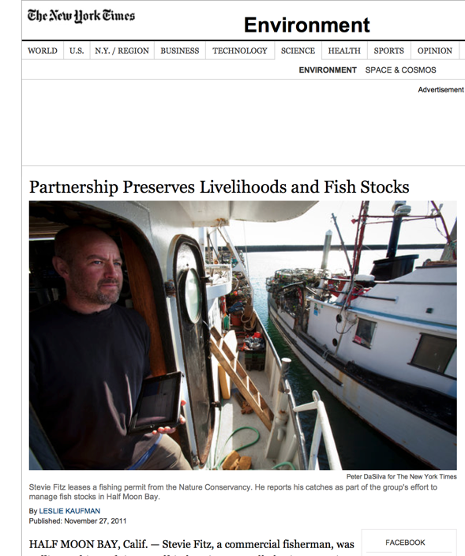
BREAKTHROUGH (Days 3 and 4):
I’m interested in “x” and would need your SS expertise to explain “y”
I’m interested in “x” and would need your QS expertise to explain “y”
Social Scientists
Quantitative Scientist
Notes:
Other than the first beer I had after climbing Mt. Bailey, this was the most exciting moment of the two weeks.
we all discussed potential project ideas
- after looking through literature/ reading about fishery, we all identified the TNC involvement in the management of risk pools in the fishery as an interesting topic.

Slide 6

NEW (socially inclusive) question:
How (if) does the existence of risk pools affect the catch of target and “choke” species?
Notes:
Addresses each group members’ interest in a variety of topics, including:
- social justice (participation in the fishery)
- cultural aspects of collaboration
- co-management and governance structures (neoliberal market-based approaches to management that fail to account for small and medium-sized participants. Only allowance for this in the ITQ FMP is the limits on the accumulation of quota shares and the moratorium on sales of QS. However, this case is interesting because it allows for the exploration of human agency and participation in finding solutions to risk associated with top-down governance approaches.
- ways to integrate social data into available trawl survey data
- come up with an understudied aspect about the changes that emerged after the implementation of ITQs

Slide 7

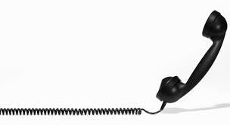
VALIDATION (Day 5):
Notes:
Had a conversation with our “client”, Todd Lee, Program Manager for the Economic and Social Science Center at the NW Fisheries Science Center in Seattle. He confirmed that it was OK to change project, and agreed that it was a novel way to explore the behavior or fishers after the ITQ implementation.
- put us in touch with people who might have more information, and apparently they have started to ask questions about participation in Risk pools as a last question on the annual renewal forms.
- question is NOT mandatory, but interesting that NOAA doesn’t require this data collection. Especially because it is a shift in management away from government to these co-managed fisher led associations that we are going to discuss further

Slide 8
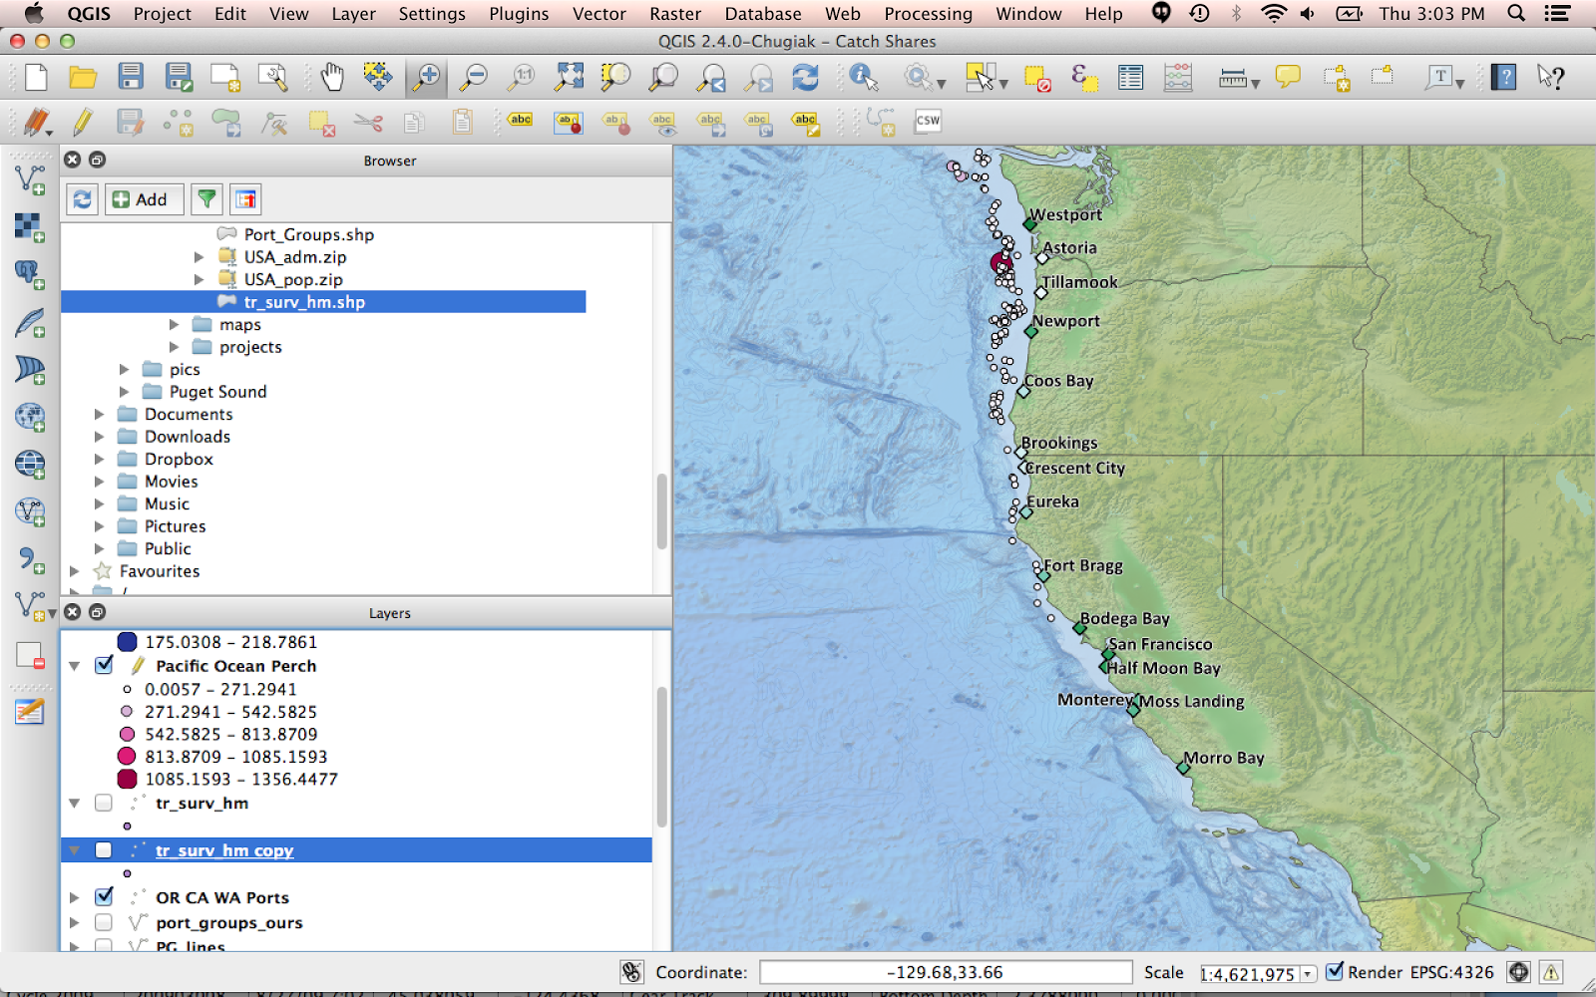
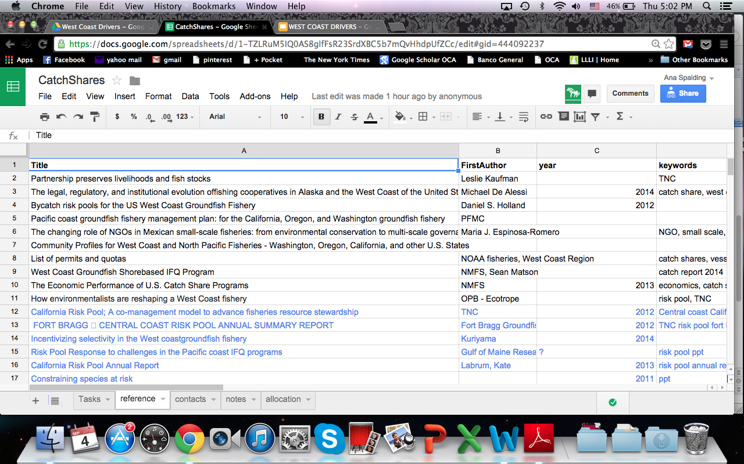
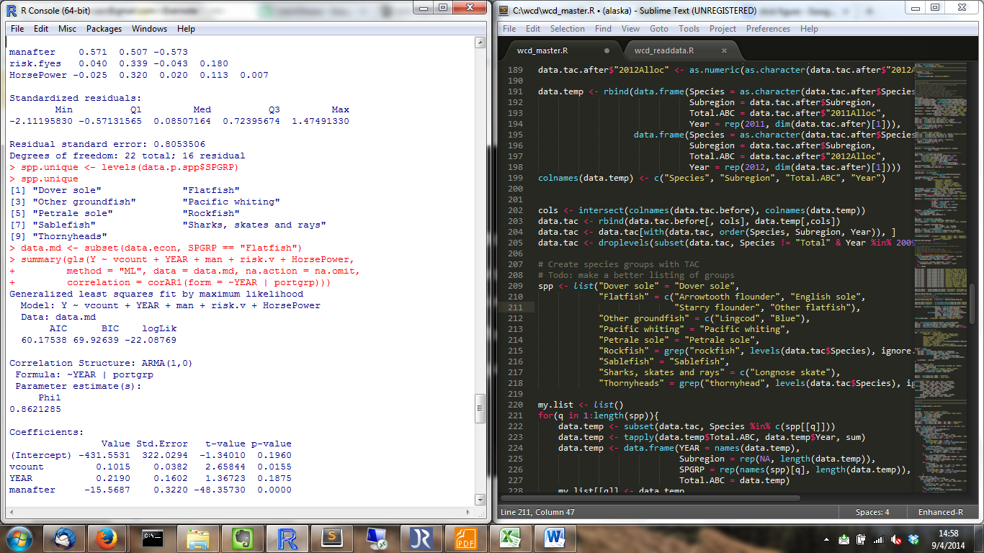
UTILIZING SKILLS & LEARNING
Social Scientists:
- literature review
- theoretical framework (governance)
- explaining outcome
- editing report
Quantitative Scientist:
- mapping
- data manipulation
- model development
- explaining outcome
- editing report
Notes:
ongoing conversations were had about how to proceed.
“tasks” were assigned, and included literature reviews, identifying the theoretical framework (governance), mapping component (that Sarah will discuss later) and the data manipulation (that Kelli will discuss later).
- you can also see that we were beginning to work on things on parallel. By having a joint question, we each felt more empowered to contribute equally to the exploration of results and to the editing of the overall erpot.
In particular, we discussed the idea of GOVERNANCE and how

Slide 9
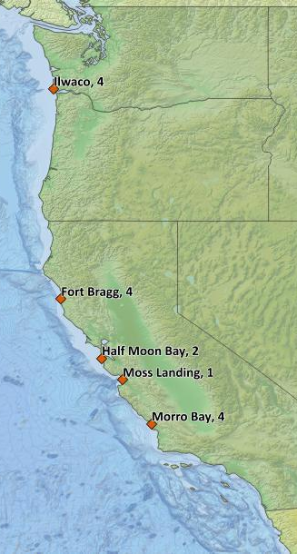
RISK POOLS - a type of fishing co-op
Members pool quota of bycatch species
Spread the risk of quota deficiency
Reduce risk of ceasing fishing or purchasing additional quota
Risk of bycatch exceeding pool’s quota
Emergence depends on ecological, socio-economic, and governance factors
Notes:
fishery cooperatives: associations of harvesters that collectively hold rights to control some or all of its members’ fishing activities. assume self interest subordinate to manage resource for community interest
biological (abundance of “choke species”, socio-economic (attainment of TAC, economic startup), and governance factors (introduction of ITQs, community engagement in fishery management, organizational capacity).

Slide 10
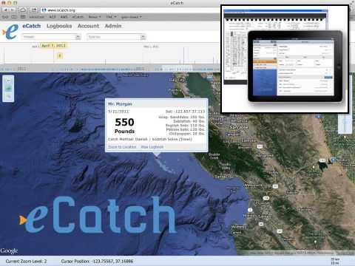
CALIFORNIA RISK POOLS
Established 2011 by TNC and fishing community
Co-management: Advisory Committee (1 rep. from each fishing association, 1 rep. from TNC)
Development and enforcement of regional fishing plans
Near real-time sharing of spatial data (eCatch, Fish Hub)
Source: The Nature Conservancy
Notes:
Nature Conservancy (TNC) entered the West Coast groundfish fishery by acquiring limited entry permits and vessels to obtain a % of the groundfish quota allocation after the ITQ was implemented in 2011.

Slide 11
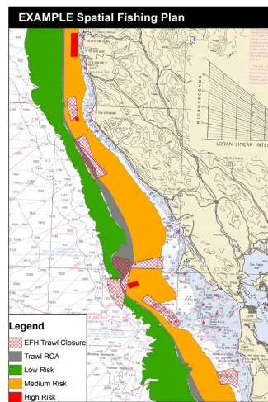
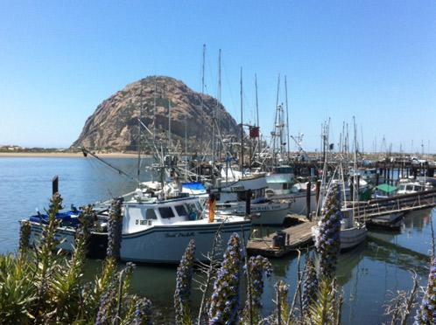
CALIFORNIA RISK POOLS
Economic goals
Maximize target species catch
Minimize bycatch of overfished species
Ecological
Safeguard sensitive fish habitat
Contribute to rebuilding of overfished species
Source: The Nature Conservancy
Notes:
very new concept, analysis of risk pool only preliminary, concept needs to prove over time that it is worth pursuing.

Slide 12
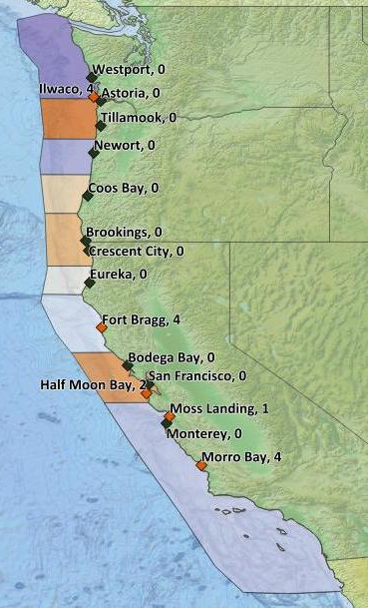

Home Ports
Grouped according to:
Biophysical boundaries
Half-way between homeports
Number of vessels in risk pool

Slide 13
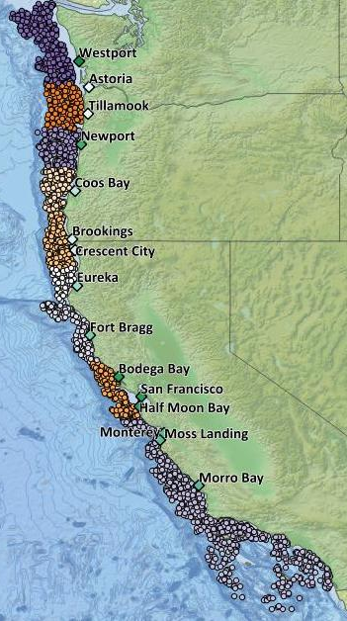
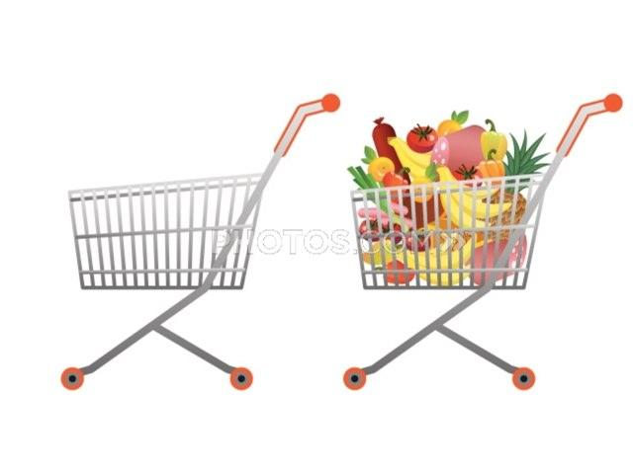
PREDICTOR VARIABLES:
Standardized trawl data
- Mean Catch per unit effort (CPUE)
- Proportion occurrence in trawls

Slide 14
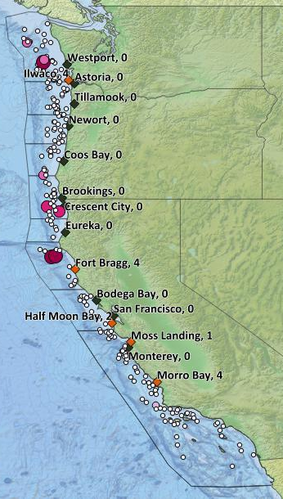
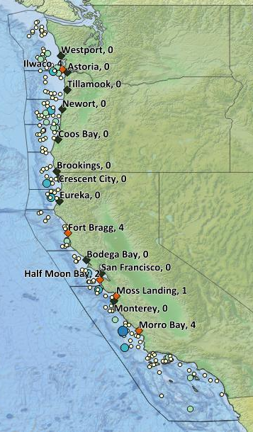
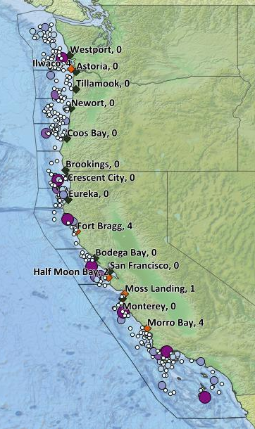
Pacific Ocean Perch
Darkblotched Rockfish
Dover Sole, Thorneyhead, Sablefish

Slide 15
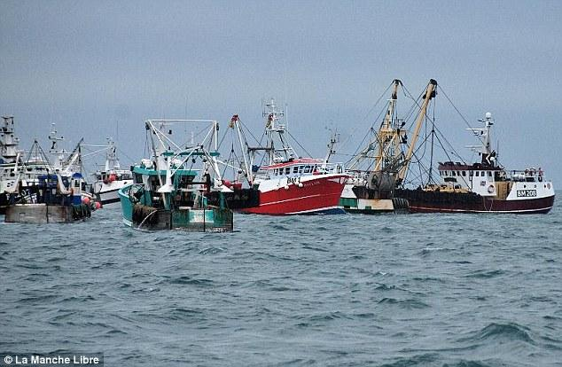
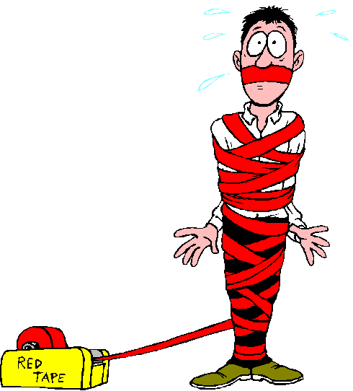
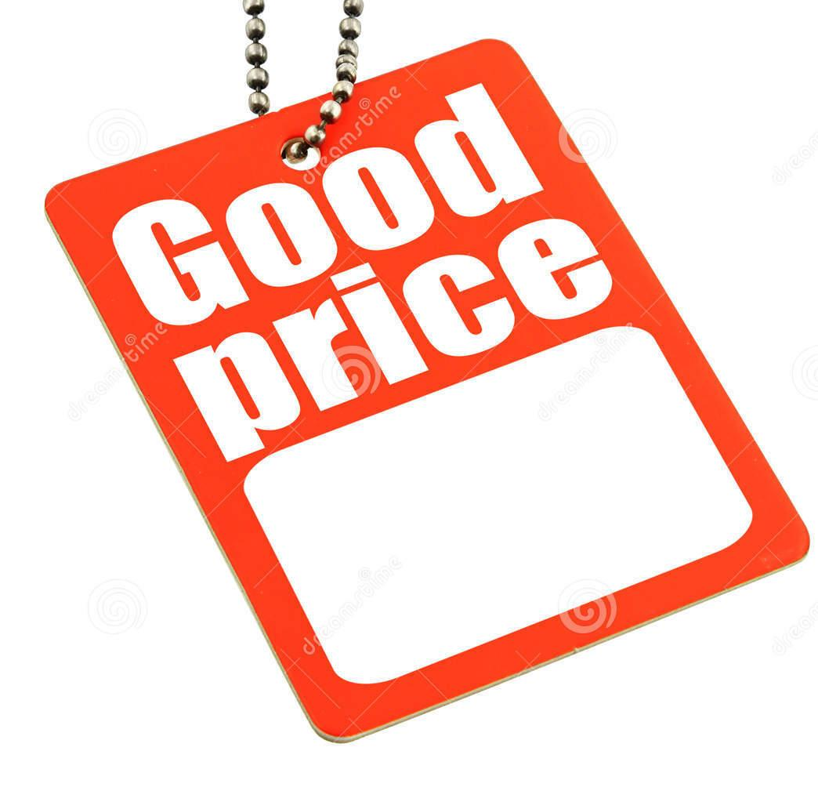
PREDICTOR VARIABLES:
Number of
vessels
Total Rev / Management
landings ($/lb) regime (ITQ)
Notes:
tot rev as proxy for ex-vessel price

Slide 16
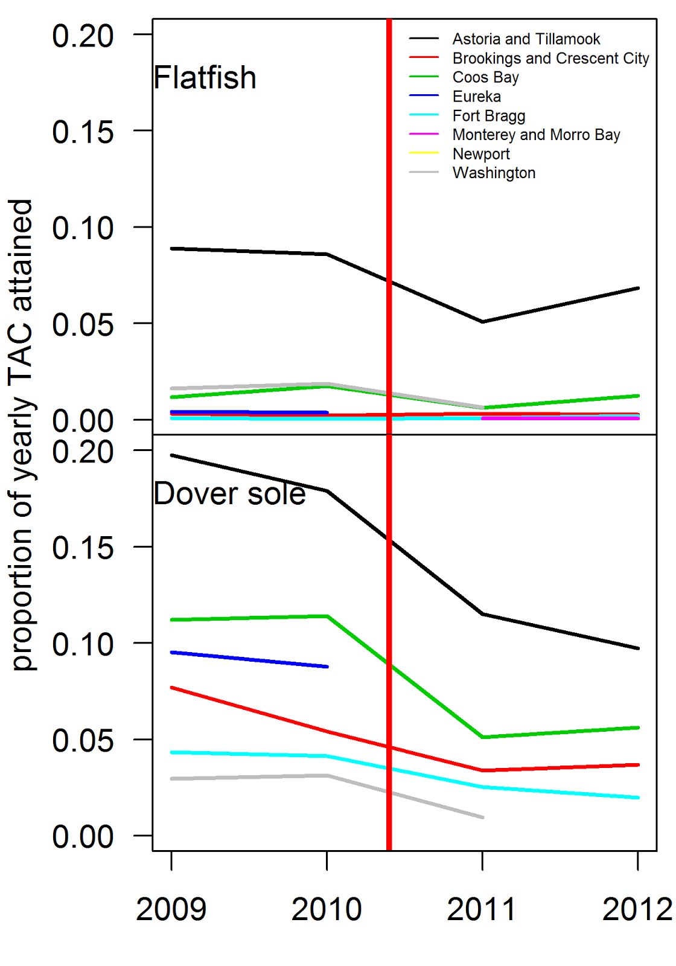

FRAMEWORK:
Assess impact of risk pools:
Y = port catch / yearly TAC
1. Flatfish complex (Near shore)
2. Dover sole (deep water)
Total allowable catch (TAC)

Slide 17
BINOMIAL LINEAR MIXED EFFECT MODEL:
=
+
+
+
+

Slide 18
Flatfish = n(+); Risk pool(-); Price(+); ITQ(+):
=
+
+
+
+

Slide 19
Dover sole = ITQ(+):
=
+
+
+
+

Slide 20
Bottom Line == It Depends:
FRAMEWORK FOR ASSESSING IMPACTS OF RISK POOLS:
Species specific outcomes
May be too early to tell
Needs: 1) better risk pool metric; 2) less aggregated $$

Slide 21
DISCUSSION:
FRAMEWORK FOR ASSESSING IMPACTS OF RISK POOLS
Potential users:
- risk pool managers
- government actors
- academics
- external industry evaluators

Slide 22
Challenges
Opportunities
Different objectives
Background knowledge of the system
Working on things we already knew, instead of learning about what others know
“Saw” R platform
Learned how to use open source software
Became familiar with how social scientists think and the types of questions they ask
Use social science data in models

